Slide 1

Data-Driven Strategies for a New Movie Studio
An analysis of market trends to guide our first productions.
Presenter: [Joel Gitonga]
Date: August 1, 2025

Slide 2
Setting the Stage for Success
The Challenge
The Goal
The Big Question
The film industry is highly competitive. For a new studio to succeed, it must make smart, data-driven decisions from day one.
This analysis dives into thousands of films to uncover the key factors that drive box office success.
How can we use data to de-risk our initial investments and maximize our chances of producing a hit?

Slide 3
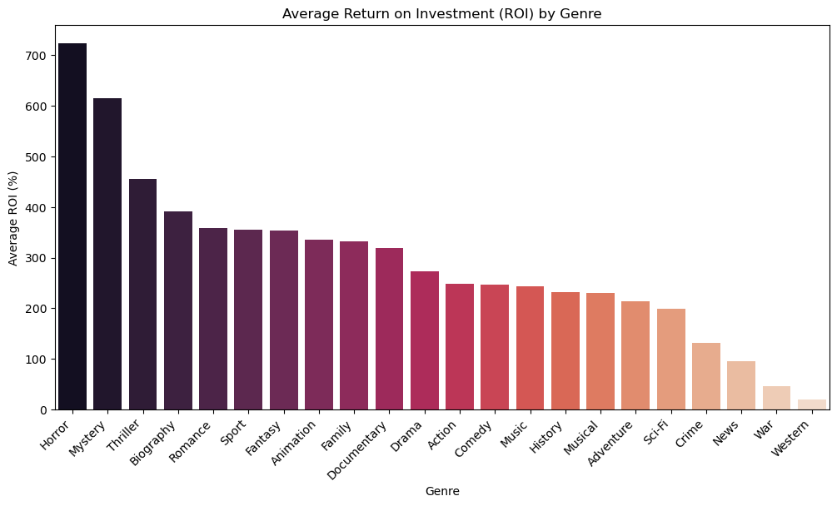
The Hidden Gem: Return on Investment
While big-budget films make more raw profit, Horror and Mystery films deliver the highest return on investment.
These genres often have much lower production costs, meaning even a modest box office success can result in a massive percentage return.
For the Studio: This is our "stand out" insight. We can produce lower-risk, high-ROI films in the Horror and Mystery genres to build capital and reputation before tackling massive blockbusters.

Slide 4
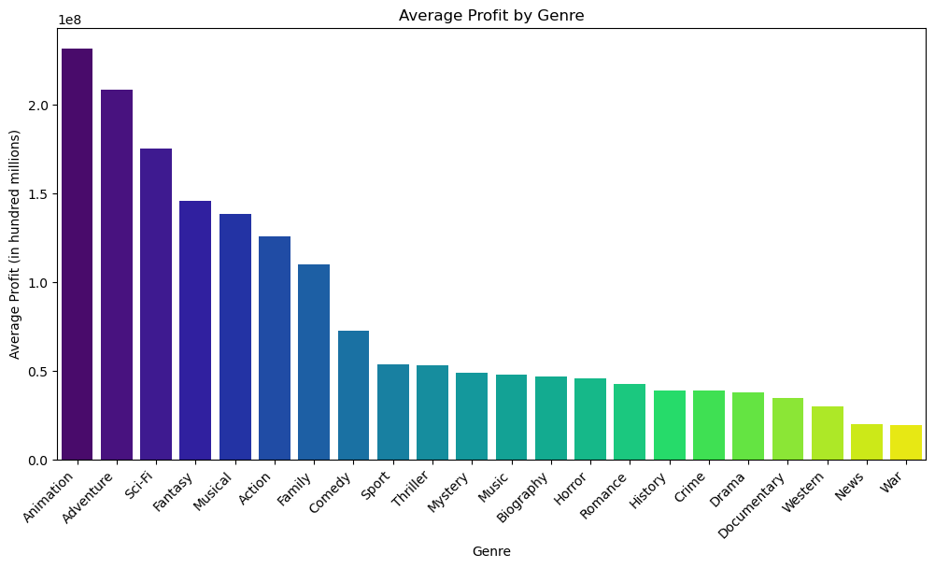
Action & Adventure Dominate the Box Office
Analysis & Key Takeaway:
The data is clear: Animation, Adventure, and Sci-Fi are the most profitable genres on average, generating hundreds of millions in profit.
These genres have a proven track record of attracting large audiences and driving significant revenue.
For the Studio: Our first major productions should strongly consider targeting these high-performing genres to maximize potential profit.

Slide 5
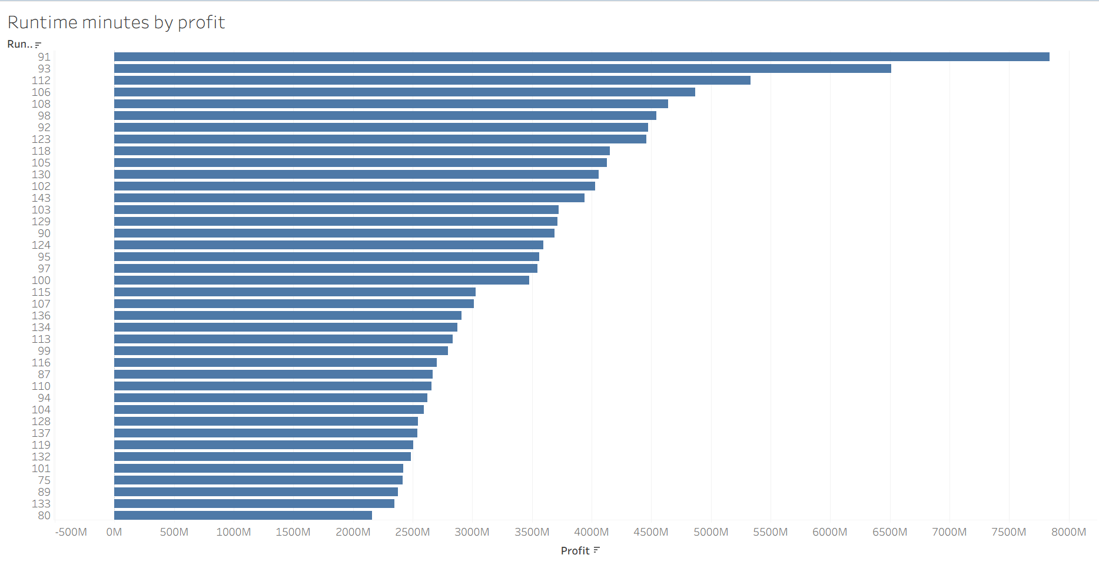
The "Sweet Spot": Runtime vs. Profitability
There's a clear trend: the most profitable films overwhelmingly fall between 90 and 150 minutes.
Movies that are too short may be perceived as lacking substance, while those that are too long can alienate audiences and limit the number of daily screenings.
For the Studio: We should aim for our films to land within this "sweet spot" to align with audience expectations and maximize commercial appeal.

Slide 6
A Three-Tiered Strategy for Success
A Three-Tiered Strategy for Success
Focus on Proven Genres: Prioritize producing films in the Action, Adventure, and Sci-Fi genres for our major releases to maximize profit potential.
Invest in High-ROI "Incubator" Projects: Simultaneously, develop a slate of lower-budget Horror and Mystery films. These will act as our financial engine, generating high returns that can fund our larger projects.
Target the "Sweet Spot": Ensure our films have a runtime between 90-150 minutes and partner with directors who have a proven track record of delivering commercially successful films.

Slide 7
Building Our Future
Building Our Future
Our Blueprint: By leveraging these data-driven insights, we can make smarter, more strategic decisions that will set our studio up for long-term success.
What's Next?
Begin greenlighting projects that align with our genre and runtime strategy.
Start outreach to directors who have a proven track record in our target genres.
Conduct further analysis into the impact of seasonality and marketing spend on profitability.

Slide 8
Thank You !

